Slide 1

“ Optimizing Revenue: A Deep Dive Into DVD Store Inventory ”
PRESENTING BY,
Nandhini V

Slide 2








Total Revenue:
$67.4k USD
# of Stores:
2
Inventory size:
4.5k
Categories in inventory:
16
“Data Highlights”
# of Films:
1k
# of Actors:
200

Slide 3
GINA DEGENERES has generated the highest revenue among actors.

Slide 4
SPORTS category has the highest revenue among other categories.

Slide 5
RENTAL RATES and REVENUE are high in the month of July 2005.

Slide 6
The both STORE 1 and STORE 2 generate almost the same revenue.

Slide 7
Title TELEGRAPH VOYAGE has generated the highest revenue.

Slide 8
Parental Guidance
under 13 year (PG-13) was the BEST-SELLING CATEGORY.

Slide 9
Both the staff Mike Hillyer and Jon Stephens
generate almost the same revenue.

Slide 10
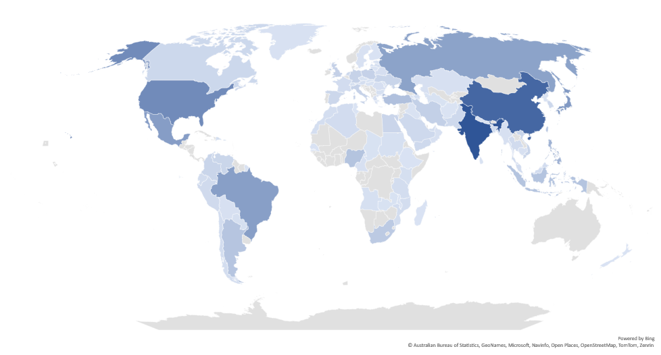
India & China contributed
most to the Revenue

Slide 11
THANK YOU

